Slide 1


Physical, Social-Emotional, & Health Safety
Dave Peters & Topher Ferreira | August 13, 2024
Notes:
Peter: Add meeting evaluation QR code here
https://forms.office.com/r/2UikFt79iN

Slide 2
INITIATIVE FRAMEWORK
PREVENTION & RESPONSESS
Consideration of the “How” and the “Why”
TYPES OF SAFETY
Physical | Emotional | Health
Comprehensive expectations & standards
Clear guidelines
Clear communication
Regular training
Consistent adherence
Evaluations & adjustments
Notes:
So taking something that could otherwise be quite overwhelming and making it simple and applicable to all areas was the goal.
So within the framework developed by the initiative team, we look at how unsafe situations can be prevented, but also why they occur. For example, aspects like key card badges, vestibules, security personnel, and surveillance are in place to prevent/discourage the “how” of something unthinkable. But it’s also critical that we try to prevent “why” someone might want to do something like that. Creating a welcoming environment and authentic sense of belonging for all our stakeholders with relationships at the center – to have our students and stakeholders be able to say, “I love this school” – we saw from our activity what would be behind a statement like that… trust, caring, a community that has your back. Likely a place that feels safe to spend your day? And people feel safer when they have some sense of control. So the realization for someone to say, “Okay, I may not have a lot of influence over legislative safety funding for my school… but I can be kind. I can look for opportunities to find a student who looks like they’re alone and befriend them, encourage them. Ensure that a struggling student is connected to beneficial resources.
So, it’s both the how and the why in the areas of PHYSICAL, EMOTIONAL, and HEALTH-related safety.

Slide 3

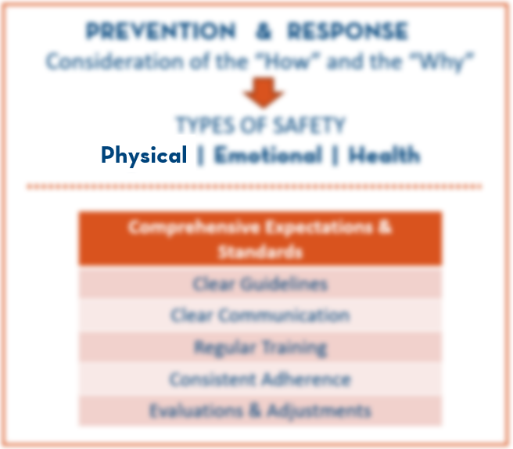
INITIATIVE FRAMEWORK
PHYSICAL SAFETY
Bullying prevention
Suicide prevention
Transportation
Food service
Athletics
Security personnel
Facility access
Surveillance / awareness
CPTED (Crime Prevention Through Environmental Design)
Crisis management
Classrooms (chemicals, sharps, fire, access)
Notes:
Although certainly not exhaustive, this list helps illustrate the breadth of elements of physical safety that live within our schools, programs, and the departments in our district.

Slide 4


INITIATIVE FRAMEWORK
EMOTIONAL SAFETY
Sense of belonging
Relational connections
  adult  student
  student  student
  adult  adult
Harassment, Intimidation
& Bullying (HIB) supports
Social-Emotional Learning
Diversity, Equity & Inclusion
Suicide awareness & supports
Mental health supports
Notes:
We must put effective measures in place to ensure our stakeholders are ACTUALLY safe, but at the individual level, it’s important that people also FEEL safe. We have a responsibility to do both in order to create and maintain environments conducive to learning and growth.

Slide 5


INITIATIVE FRAMEWORK
HEALTH SAFETY
Hygiene
Food service
Heath rooms
Immunizations
Protective equipment
Individual health plans
Substance use prevention
Infectious disease protocols
Community health partnerships
Notes:
And health safety, particularly with its relationship to student and staff attendance and performance, has an important place of emphasis as well. These three components – physical, emotional, and health safety – are the foundation for our district framework.

Slide 6
Welcome
ELEMENTARY
12:30-12:40 | Welcome, Introductions and Overview of Training
12:40-12:50 | Preview of October 11 Learning Improvement Day
12:50-1:30 | RULER Refresh for 2024-25
1:30-2:10 | Forefront Suicide Prevention
2:10-2:20 | Break
2:20-3:05 | Safety & Emergency Preparedness
3:05-3:50 | Emergency Opterations Procedure Updates
3:3:50-4:00 | Break
4:00-4:15 | HIB Reporting for Vector Alerts
4:15-4:30 | Wrap-up & Closing
Notes:
Adam Pazder

Slide 7

Preview of Oct. 11 Learning Improvement Day
SECONDARY | ELEMENTARY | ACTIVITY
7:30-7:40 | 8:00-8:10 | Dr. Saltzman's video WELCOME
7:40-8:00 | 8:10-8:30 | Section One: Our school’s WHY
8:00-9:00 | 8:30-9:30 | Regrounding and depth with RULER | Zoom w/ Marc Brackett
9:00-9:20 | 9:30-9:50 | Partner Processing RULER
9:20-9:30 | 9:50-10:00 | BREAK
9:30-11:00 | 10:00-11:30 | LEARN Suicide Prevention | Zoom w/ Forefront Team
11:00-11:45 | 11:30-12:15 | LUNCH
11:45-1:45 | 12:15-2:15 | Section Two: SEL in SGG rubrics | Six Themes of CRE
1:45-2:45 | 2:15-3:15 | Section Three: SEL Processing & ACTION PLANNING
2:45-3:00 | 3:15-3:30 | Section Four: CONNECTIONS & TRANSFER, OPTOMISTIC CLOSURE
Notes:
Adam Pazder

Slide 8



SEL Refresh | Focus & Timelines
Elementary Schools | 2024-25 School Year

Slide 9

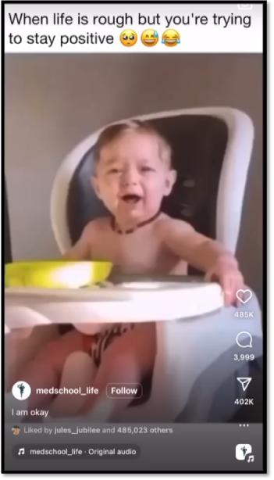
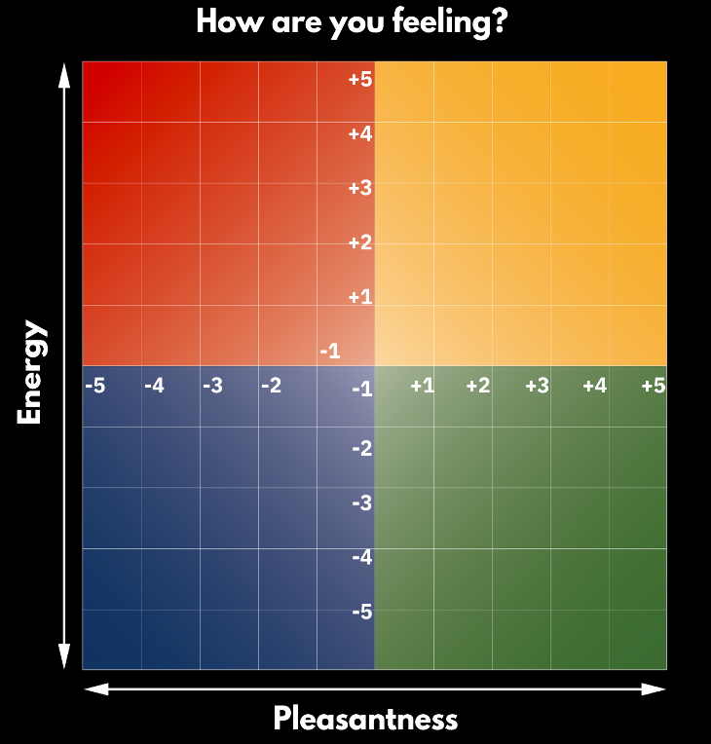




How are you feeling today?

Slide 10
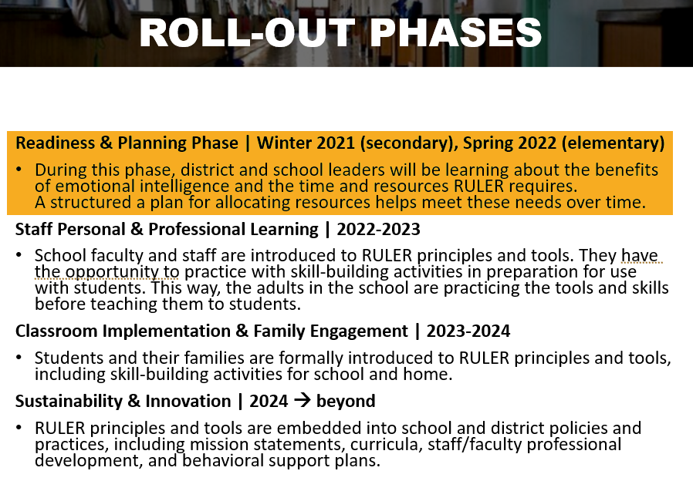
Our RULER Journey in EPS

Slide 11
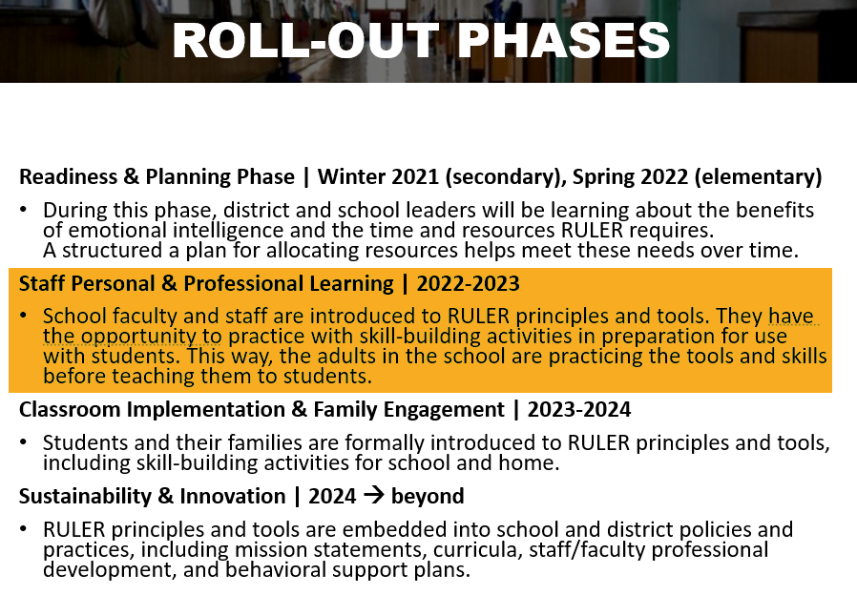
Our RULER Journey in EPS

Slide 12


Learning Improvement Day | October 14, 2022

Slide 13
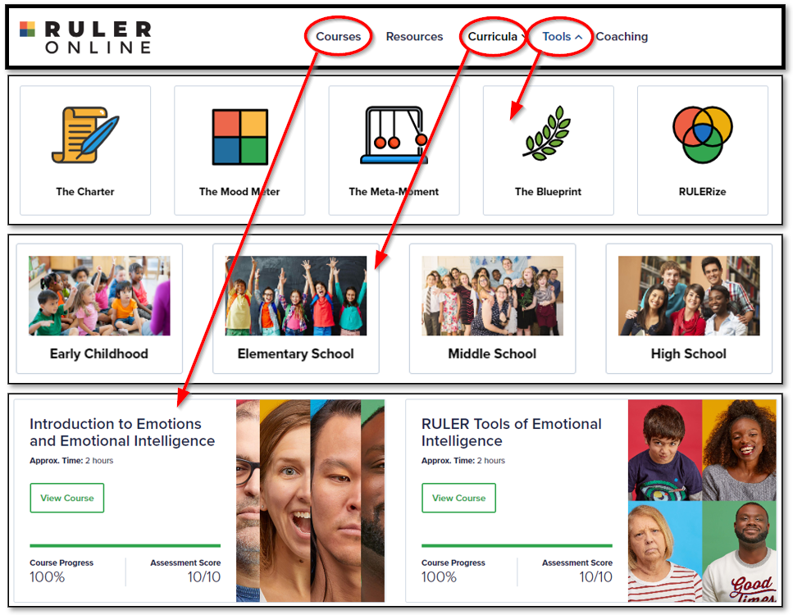
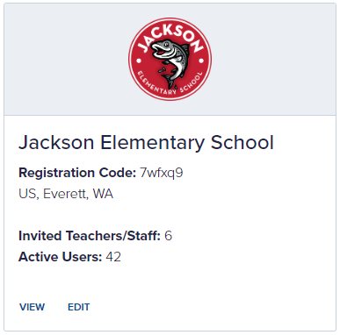
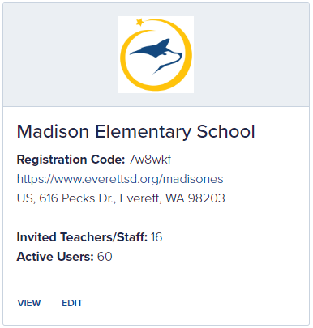
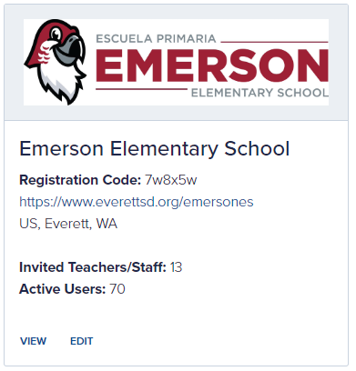
RULER Online Dashboard

Slide 14
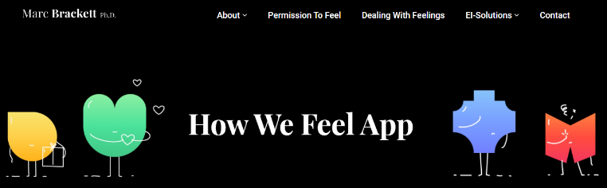


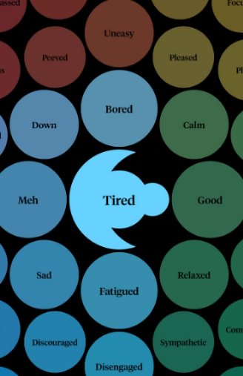

Additional Resources

Slide 15
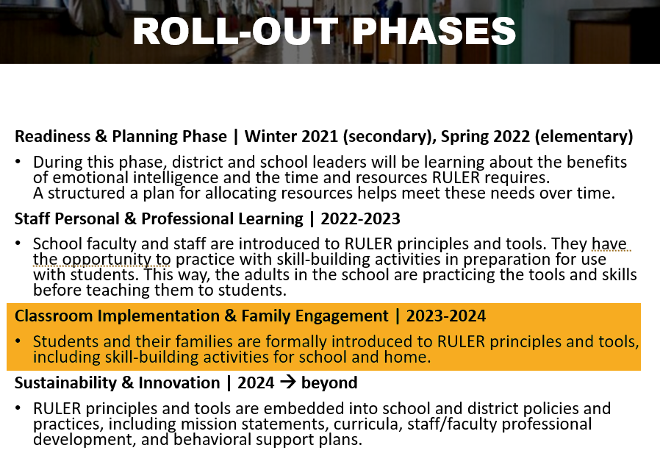
Our RULER Journey in EPS

Slide 16
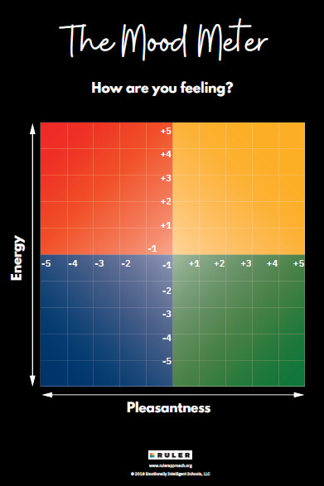
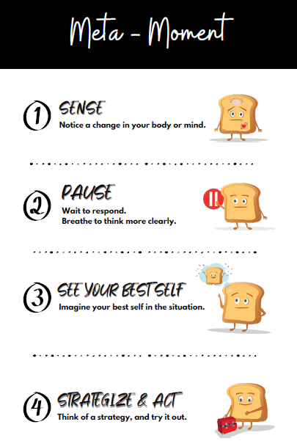
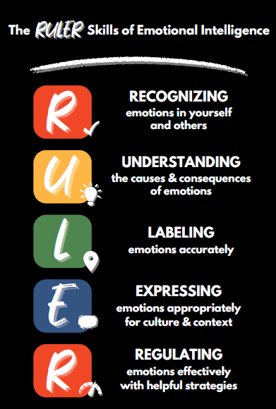
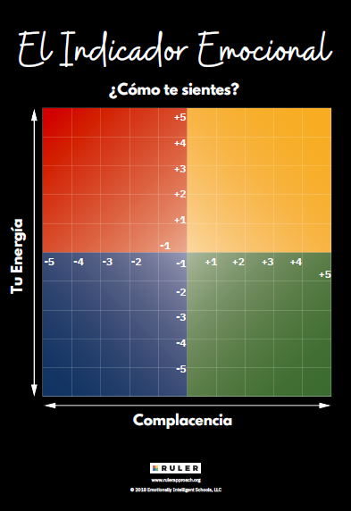
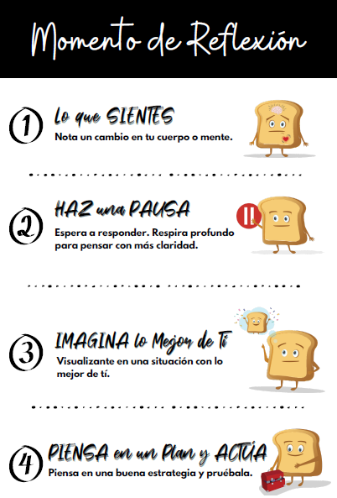
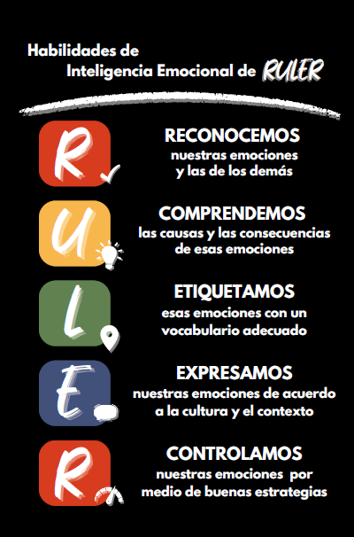
Posters

Slide 17


School Cohort Sessions

Slide 18
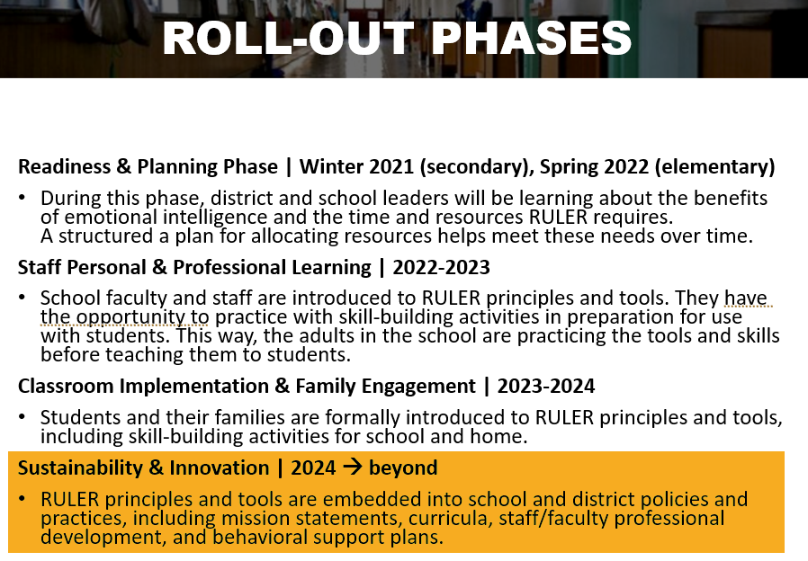
Our RULER Journey in EPS

Slide 19
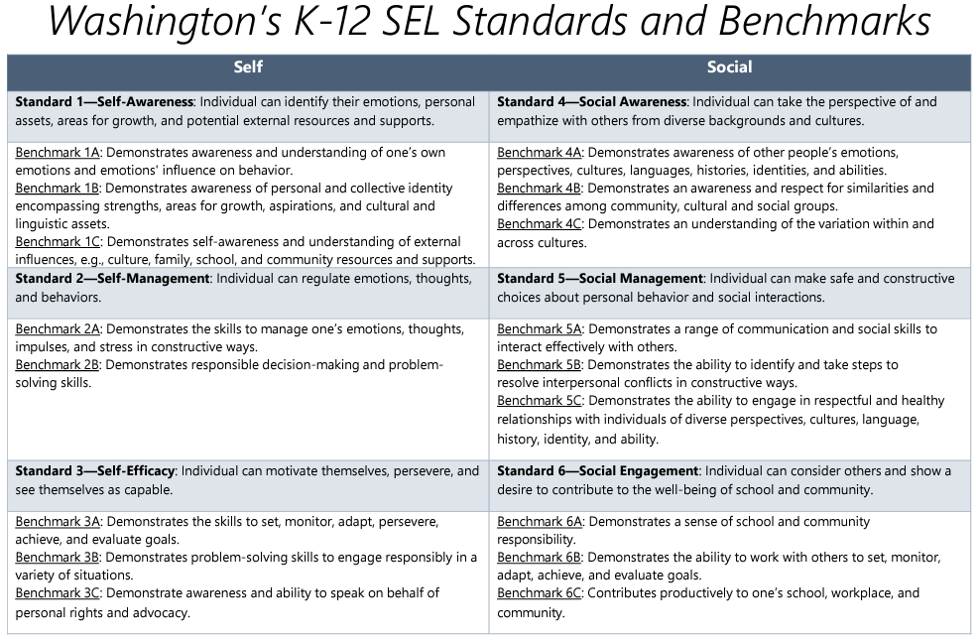
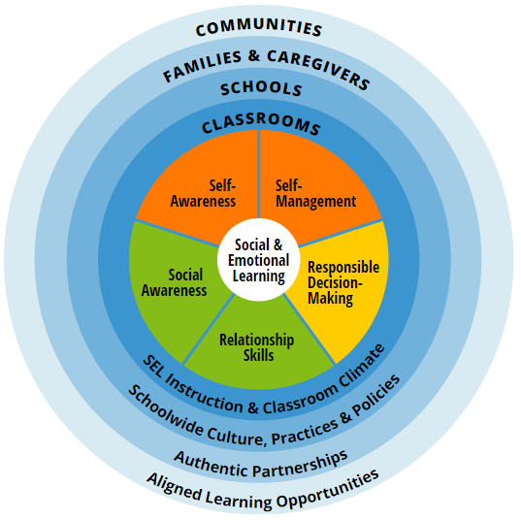


SEL Standards

Slide 20
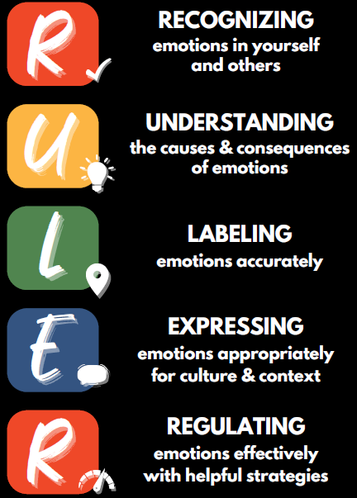
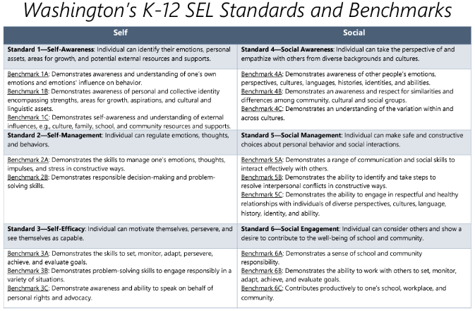

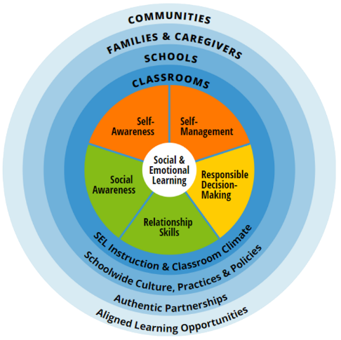
Connections to RULER
At your tables…
Identify which RULER Skills or Anchor Tools are associated with each of the:
WA SEL standards
The CASEL 5

Slide 21


The SEL Approach in EPS
Notes:
Behavior improves w/ common RULER vocabulary – recess paras won’t know which Second Step lesson you taught today

Slide 22
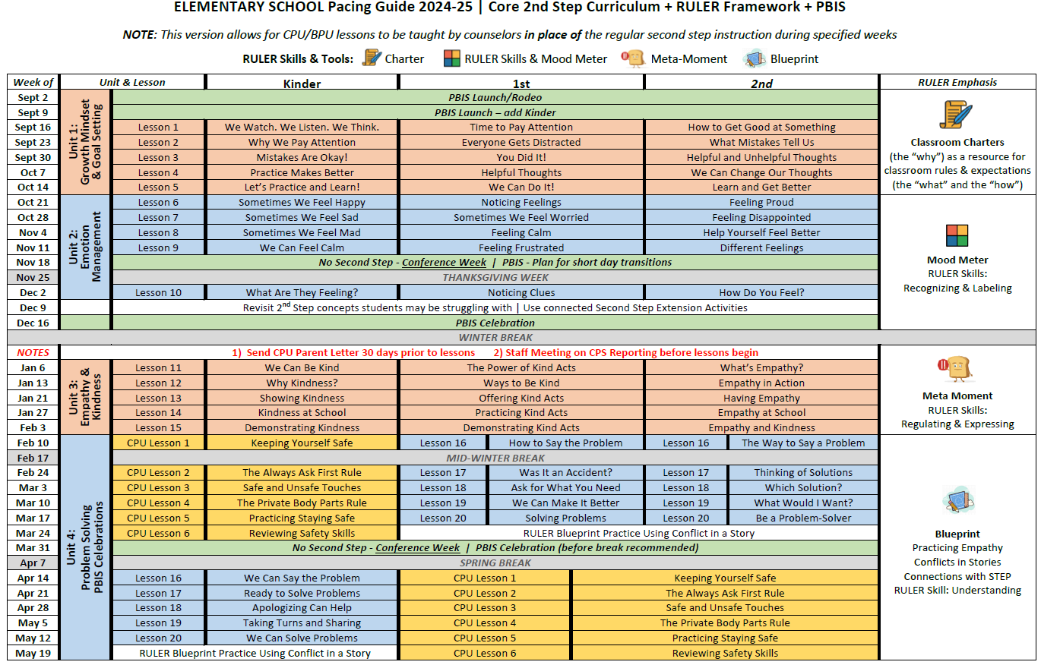
Updated SEL Pacing Guide

Slide 23
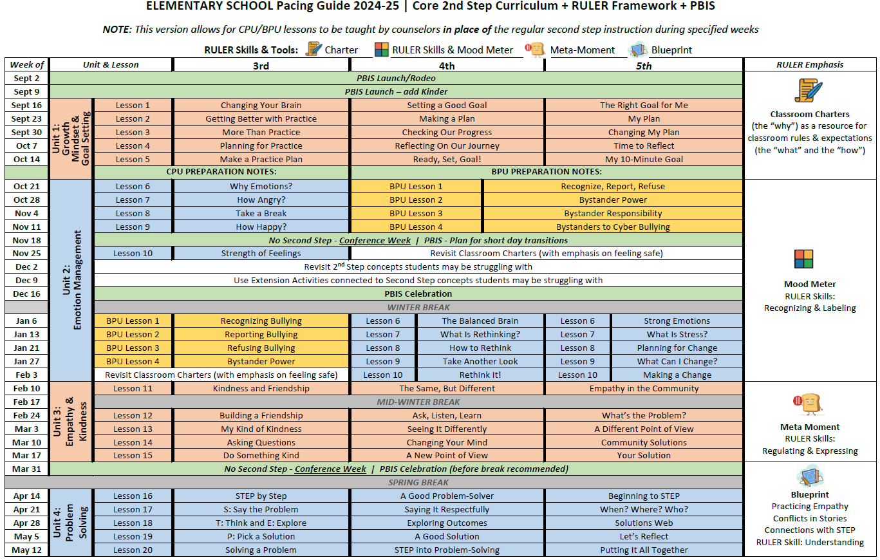
Updated SEL Pacing Guide

Slide 24
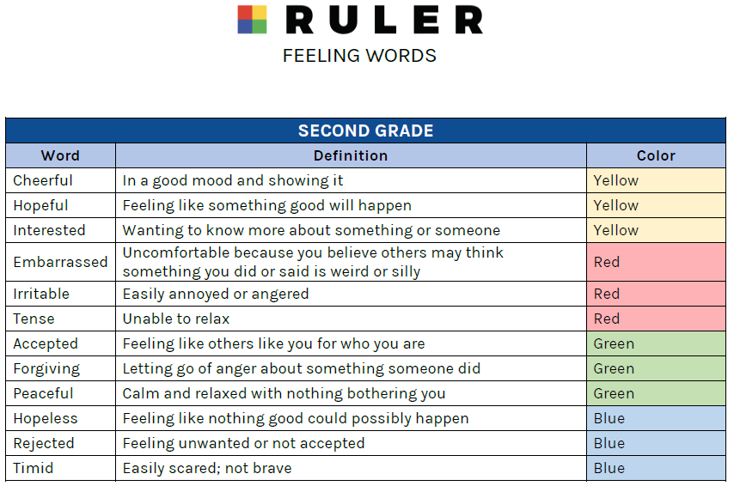
Additional Resources | RULER

Slide 25
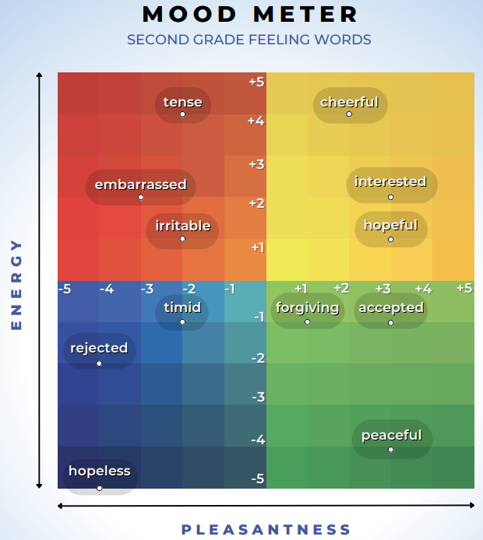
Additional Resources | RULER

Slide 26
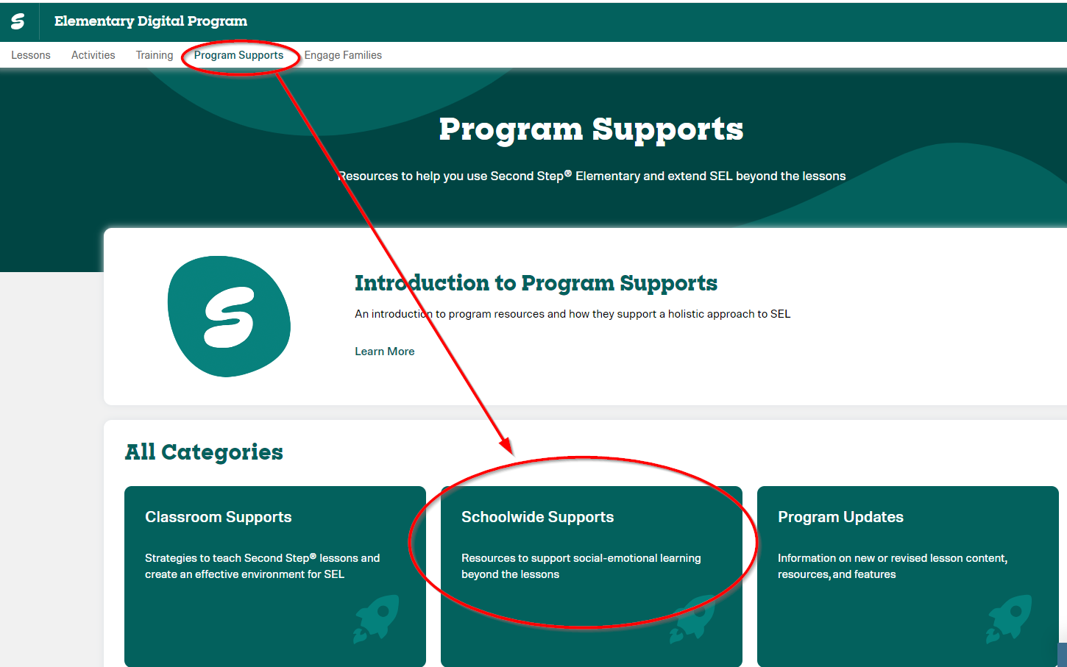
Additional Resources | Second Step

Slide 27
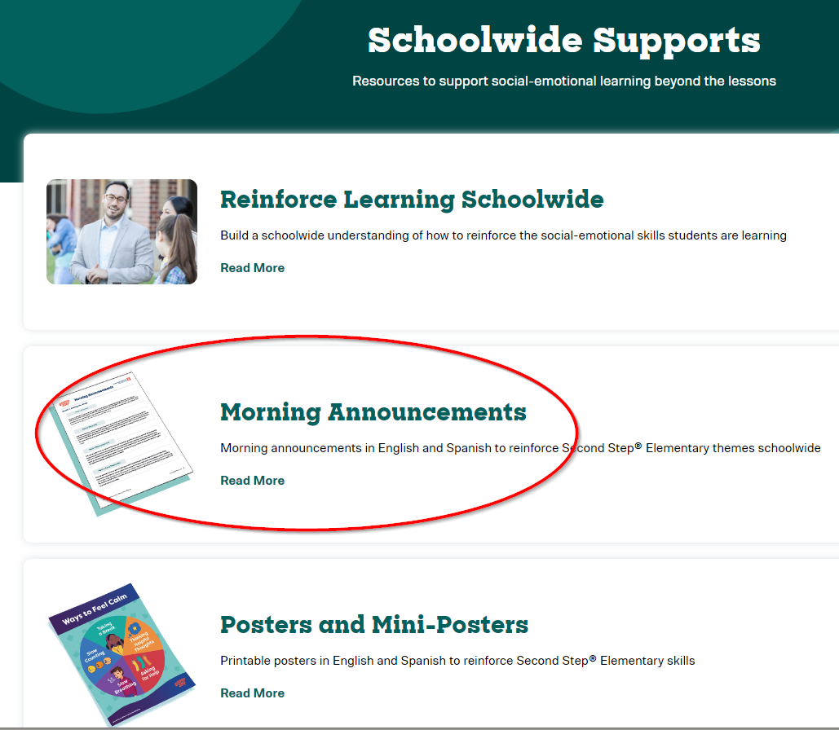
Additional Resources | Second Step

Slide 28
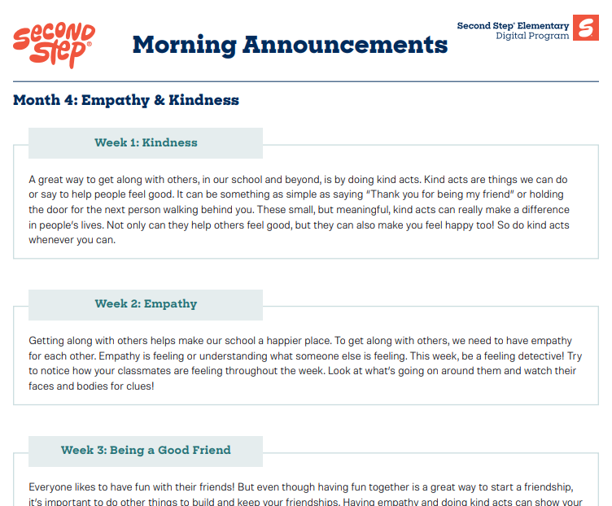
Additional Resources | Second Step

Slide 29


Canvas Portal

Slide 30

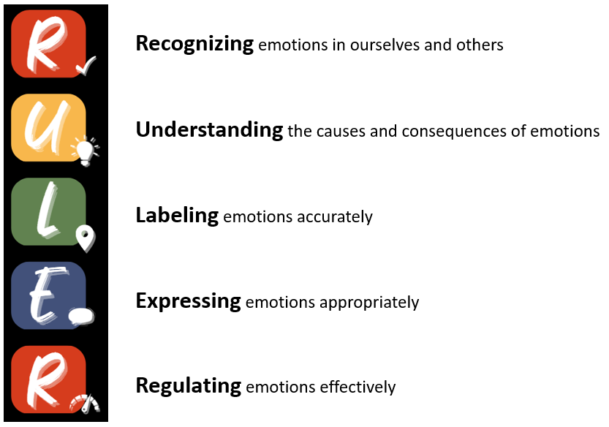



What are YOUR Goals for this Year?

Slide 31
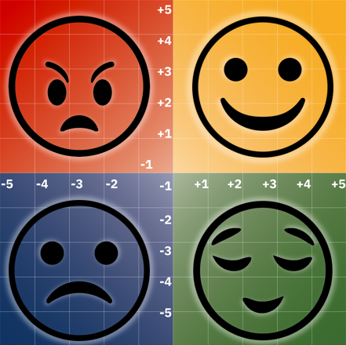




Slide 32
LEARN Saves Lives:
Suicide Prevention Training
Learning Improvement Day
All-Staff Training
October 11, 2024
Notes:
Pre-training survey link: https://redcap.link/fis_learn_pre
Participant packet link: https://redcap.link/staff_docs
Welcome to today’s “LEARN Saves Lives Suicide Prevention Training”. This training was developed by Forefront Suicide Prevention, a Center of Excellence at the University of Washington’s School of Social Work.
As we get settled, please complete the pre-training survey if you haven’t already.
You can access the survey by scanning the QR code on the slide with your phone.
LEARN Training Implementation Tips
FACILITATOR NOTES: Italicized information includes tips for the instructor (e.g., reminders to keep the audience moving, animated slide, timing of activities etc.
ACTIVITY: These sections include additional audience engagement.

Slide 33
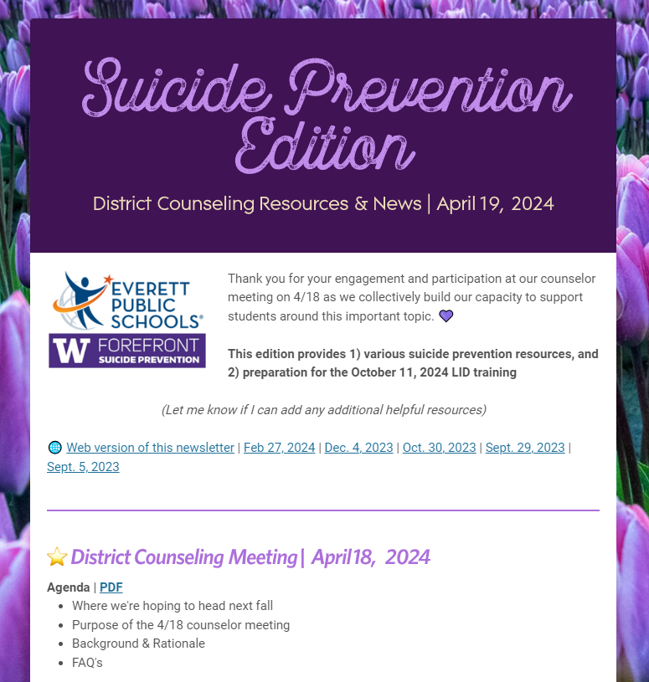
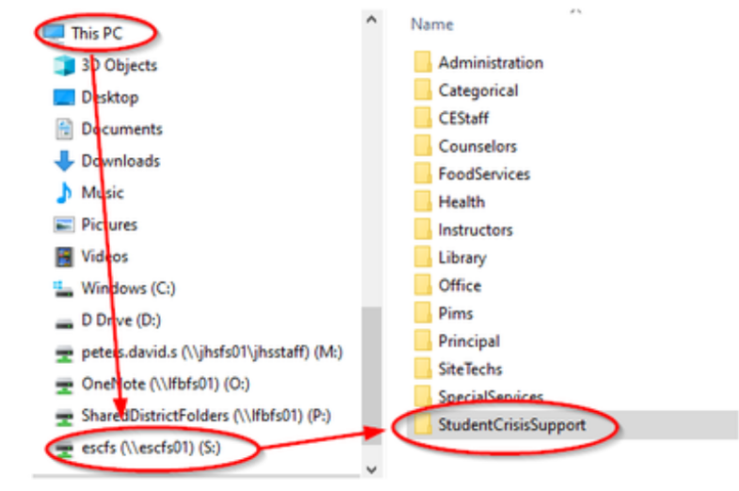
INFRASTRUCTURE
DEVELOPMENT
LEARN
Notes:
FOR IN-PERSON TRAINING ONLY - OTHERWISE SKIP
Let’s go through a bit of housekeeping before we begin the training today.
This training will take approximately [60-90] minutes
There will be one activity for you to practice the skills you’ll learn later.
If you have any additional questions, please don’t hesitate to ask.

Slide 34

OCT. 11 LID PLANNING
WHERE WE’RE HEADING THIS FALL
As part of the Learning Improvement Day agenda on October 11, 2024, the idea is that each school will divide their certificated and classified staff into classrooms of about 20 participants. A Forefront trainer will lead a LEARN training via Zoom webinar simultaneously across the district. Each room will have a trained staff member present in person to help with facilitation of this session.
BACKGROUND & RATIONALE
In Washington each year, school districts alternate annually between a professional learning focus on Diversity, Equity, & Inclusion (DEI) and Social & Emotional Learning (SEL). The 2024-25 school year will have an SEL emphasis. School Board Policy (2145) and Procedure (2145P) set expectations for suicide prevention training to be provided annually to help staff identify and respond to students at risk of suicide. Everett Public Schools is a cohort district with the University of Washington’s Forefront in the Schools suicide prevention program, and LEARN is the acronym for five steps to recognize signs of suicide and respond in a manner that can help save someone’s life.
LEARN
Notes:
FOR IN-PERSON TRAINING ONLY - OTHERWISE SKIP
Let’s go through a bit of housekeeping before we begin the training today.
This training will take approximately [60-90] minutes
There will be one activity for you to practice the skills you’ll learn later.
If you have any additional questions, please don’t hesitate to ask.

Slide 35
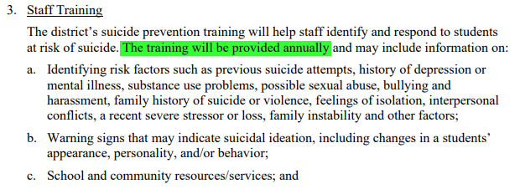
OCT. 11 LID PLANNING
LEARN
Notes:
FOR IN-PERSON TRAINING ONLY - OTHERWISE SKIP
Let’s go through a bit of housekeeping before we begin the training today.
This training will take approximately [60-90] minutes
There will be one activity for you to practice the skills you’ll learn later.
If you have any additional questions, please don’t hesitate to ask.

Slide 36




Forefront’s Mission
Forefront Suicide Prevention is a SSW Center of Excellence.
Our mission is to help people take action to prevent suicide in their communities.
Notes:
Forefront’s mission is to help people take action to prevent suicide in their communities. To that end, Forefront has provided suicide prevention training to nearly 70,000 professionals and community members across WA state, championed 11 state laws, and positioned our state as the first to require health professionals to have suicide prevention training.
Founded in 2013. We are a Center of Excellence, not considered a research center, but we think ourselves more of an action center. Our training programs are evidence-informed, but we’re working towards being able to classify our products as evidence-based as we pursue publications, and Zoe will talk more about that later.
Started by UW School of Social Work professors, Sue Eastgard, M.S.W., a national leader in youth suicide prevention, and Jennifer Stuber, Ph.D., a public health policy expert, to address suicide prevention at a public policy level.
Our early focus was on advocating for the first laws in the U.S. requiring that every behavioral health professional and health care provider in the state receive suicide prevention training, and we developed and delivered training programs statewide to meet these requirements.
In 2015, we founded Forefront in the Schools, a comprehensive, multi-year suicide prevention program that provides schools with a framework and tools to address youth suicide and suicidal behavior through an integrative approach. Over 50 schools have joined the program to date.
In 2015 we also launched Forefront Suicide Prevention LEARN®, our gatekeeper training.
In 2016, our work expanded to support a higher education task force formed by the state to improve suicide prevention programming in 2- and 4-year higher ed institutions across Washington.
In 2018, we started Safer Homes Suicide Aware, a program teaching practical skills and distributing free locking devices to help change public behavior on limiting unauthorized access to firearms and medications, which are the two most common means of suicide. Known as “lethal means safety”, this is one of only four interventions that is known to reduce suicide rates at population levels.

Slide 37



Suicide affects all communities
Suicide results from multiple complex factors
Suicide prevention efforts require a comprehensive, multi-tiered approach
Asking about suicide does not cause suicide
What we know
Notes:
There are lots of myths about suicide, and many things we still don’t know. But let’s start with what we do know.
Suicide affects all communities:
People of any background can be at risk for suicide, no matter their identity.
It is true that some groups are at higher risk for suicide; this includes veterans, LGBTQ+ communities, and American Indian/Alaska Natives.
Suicide is the result of multiple complex factors:
Many stories of suicide tend to focus on one cause.
But, the majority of suicides are due to multiple factors, sometimes going back many years.
Suicide Prevention efforts require a comprehensive, multi-tiered strategic approach
Asking about suicide does NOT cause suicide. It’s very common to be concerned that asking about suicide plants the idea in someone’s head. However, we know that asking about suicide doesn’t cause suicide, and in fact, asking can actually lower the amount of distress that someone is experiencing.

Slide 38

What protects against suicide?
Connections to friends, family, culture, and community
Limited access to lethal means (e.g., firearms, medications)
Coping and problem-solving skills
Access to physical and mental health care
Notes:
Suicide can be a complex topic.
Experts are still learning more about what makes someone at risk for suicide.
We also are learning a bit more about what protects against suicide.
We know that each of the following are protective factors against suicide:
Connections to friends, family, culture, and community.
Limited access to lethal means (e.g., firearms, medications).
Coping and problem-solving skills.
Access to physical and mental health care.

Slide 39

Suicidal thinking
Suicide isn’t always about wanting to die.
It’s about wanting
to end overwhelming pain.
Notes:
To understand a bit more about the suicidal mindset, people who are considering suicide often feel deeply alone and like a burden to those around them.
These thoughts can cause deep psychological and emotional pain, and lead people to conclude that the way to end that pain is to die.
Suicide isn’t always about wanting to die. It is about wanting to end overwhelming pain.

Slide 40


Youth in the US, 2021
Youth suicides account for
15% of all suicides
Suicide is the 2nd leading cause of death among those ages 10-24
LEARN
Notes:
For context, let’s review some basic statistics about suicide and youth in the United States.
Suicide is the 2nd leading cause of death among young people ages 10-24.
Youth suicides account for 15% of all suicides (as of 2021).

Slide 41

What Washington youth are saying
HYS: Suicidal Feelings and Actions
Notes:
The Washington State Healthy Youth Survey (also known as HYS) is a collaborative effort between statewide agencies to measure different health behaviors among youth. It’s a bi-annual survey given to 8, 10, 12 graders.
2023 HYS results just released and we are seeing a positive trend in these statistics, which is very encouraging, but there is still a lot of work to be done.
In 2021, across grades 8, 10 and 12:
Approximately 1 in 5 Washington State students reported considering suicide in the last year.
15-16% of our youth reported making a plan to end their life.
7-9% of our teens made a suicide attempt.
FACILITATOR NOTE
Data from HYS 2021 - Washington: Suicidal Feelings and Actions: Students who report considering suicide, making a suicide plan, and attempting suicide in the past year
Participants can explore the healthy youth survey data on their own here: https://www.askhys.net/
Audiences can sometimes have many questions about the statistics. Encourage data enthusiasts to go to these websites:
https://suicidology.org/facts-and-statistics
https://save.org/about-suicide/suicide-statistics/

Slide 42
Our model:
Look for signs
Empathize & listen
Ask about suicide
Reduce the danger
Next steps
LEARN
Notes:
JENNIFER Slides 25-30
LEARN is the acronym we use to help remember these potentially life-saving skills.

Slide 43

Look for signs
Look for signs
Empathize & listen
Ask about suicide
Reduce the danger
Next steps
LEARN
Notes:
We start with the L step, which stands for “Look for signs.”
Many people who are considering suicide will show warning signs.
In the next slides, we’ll go through a few common warning signs for suicide.
Signs can indicate a risk for suicide.
They help us know what actions to take with an individual.
They can and should be used to start a conversation.

Slide 44
Look for warning signs
Emotions, Feelings
Actions, Behaviors
Experiences
  Depression, anxiety
  Anger, irritability, agitation
  Unusual mood swings
  Feeling hopeless/helpless
  Loneliness
  Shame, humiliation
  Emotional/physical pain
  Sudden unexplainable joy after a period of depression
  Withdrawing
  Isolating
  Substance use
  Giving away prized possessions
  Acquiring lethal means
  Risky/reckless behavior
  Joking/frequent statements about death
  Self-injury
  Threats against self or others
  Significant life changes or loss
  Bullying, harassment
  Discrimination linked to sexual orientation, gender identity, and/or race/ethnicity
  Personal and/or historical trauma
  Previous suicide attempts or family history of suicide
  Access to lethal means
LEARN
Notes:
This is a list of common warning signs. Take a minute to glance through each section. Think of these signs as falling into three “categories”: Emotions/Feelings, Actions/Behaviors & Experiences
The list of warning signs in the Emotions/Feelings category probably doesn’t surprise you, but let’s highlight the last bullet point. Why would sudden joy after a period of depression potentially be a warning sign that someone could be at risk for having suicidal intent? …A sense of relief from the idea that they may soon be escaping their overwhelming pain…
Let’s look at a few of the warning signs listed under Actions/Behaviors:
Substance use… Alcohol decreases inhibitions. It also increases impulsivity, depressive or negative feelings and all-or-none thinking.
Self-injury can be a warning sign for suicide BUT, it can also occur without suicidal intent.
It is most often used to regulate emotional pain vs ending one’s life.
Never ignore self-injury - it indicates a need for care whether the person has suicidal intent or not.
Finally, we’ll look at a few experiences that may increase someone’s risk for suicide.
Discrimination, racism, personal and/or historical trauma, and violence linked to significantly contribute to suicide risk.
We’ll talk more about access to lethal means in future slides.

Slide 45

Empathize & Listen
Look for signs
Empathize & listen
Ask about suicide
Reduce the danger
Next steps
LEARN
Notes:
The next step is Empathize and listen.
Empathy and listening play important roles in deepening everyday relationships, and we know that a sense of Connection, Belonging and Purpose play a huge role in suicide prevention.

Slide 46
Components of empathy
Helpful things to say:
I’m so glad you told me.
Tell me more, I’m listening.
Try to see the world as others see it
Be non-judgmental
Validate another’s feelings
Communicate understanding
LEARN
Notes:
Even if we know what empathy is, sometimes it can still be hard to demonstrate it in the moment when emotions are heightened, especially in the midst of a situation that feels like a potential crisis.
Here are 4 components of empathy:
See the world as others see it.
Be nonjudgmental.
Validate another’s feelings.
Communicate that understanding.
You don’t need to agree with someone’s feelings or fully understand why they feel the way they do to effectively demonstrate genuine empathy, but you do need to understand HOW they feel and strive to be able to share that back with them so they feel truly seen and heard.
People who’ve survived suicide attempts say listening is what they needed most.
See the examples of how to communicate empathy in the top right hand corner.

Slide 47

Ask about suicide
Look for signs
Empathize & listen
Ask about suicide
Reduce the danger
Next steps
LEARN
Notes:
ZOE Slides 31-39
Now that we’ve learned how to identify someone in distress and how to build an empathetic connection, we’re ready to move on to the A step, “Ask about suicide.”
Remember, asking about suicide does not make it more likely that a person will consider suicide.

Slide 48

How do I ask about suicide?
Sometimes when people are…
_______________________,
_______________________,
_______________________,
they’re thinking about suicide.
Are you thinking about suicide?
Insert any warning signs
you see here!
Example:
“Sometimes when people are feeling depressed and isolated and are also going through a major life change, they’re thinking about suicide. Are you thinking about suicide?”
Notes:
Next, we’ll learn a phrase to use when asking about suicide. We recommend using this method.
“Sometimes when people are ______, they’re thinking about suicide. Are you thinking of suicide?”
In the blank spaces, you can insert some of the warning signs that you have observed or heard.
Here is an example of using the formula with some warning signs:
Sometimes when people are feeling depressed and isolated and are also going through a major life change, they’re thinking about suicide. Are you thinking about suicide?”
This formula is helpful because:
Saying ‘people’ and ‘they’ help normalize their experiences and thoughts.
Including the warning signs you’ve observed shows that you are really listening to what they are going through
When you ask, be prepared to hear a ‘yes’. Not everyone will say ‘yes’, but it’s good to make sure that you are ready and prepared for that answer.

Slide 49
Important follow up questions
Have you thought about how you might end your life?
Have you thought about when you might do this?
Do you have access to those methods?
Remember: Putting time and distance between a suicidal person
and the methods they may use can save their life!
LEARN
Notes:
We recommend asking additional clarifying questions:
Have you thought about how you might end your life?
Do you have access to those methods?
Have you thought about when you might do this?
These questions will help you understand what information to pass on to helpful resources or what steps you might need to take yourself.
Asking follow-up questions can help us:
Understand the level of risk this person may be posing.
Example - No plan vs an active plan with access to lethal means.
Help determine whether or not emergency services are needed.
Continue to show compassion and care, even if what you are hearing is difficult or scary.
Remember, putting time and distance between a suicidal person and the methods they may use can save their life!

Slide 50

Reduce the danger
Look for signs
Empathize & listen
Ask about suicide
Reduce the danger
Next steps
LEARN
Notes:
Next is the “R” step: Reduce the danger.
This step is about taking practical action to keep someone safe.
This means reducing or removing access to things someone could use to end their life.

Slide 51


Safer Homes
Notes:
ZOE Slides 20-25
This mighty team of 3 works across the state to increase public awareness of safe storage practices, to keep firearms owners and those who use medication safe from suicide.

Slide 52
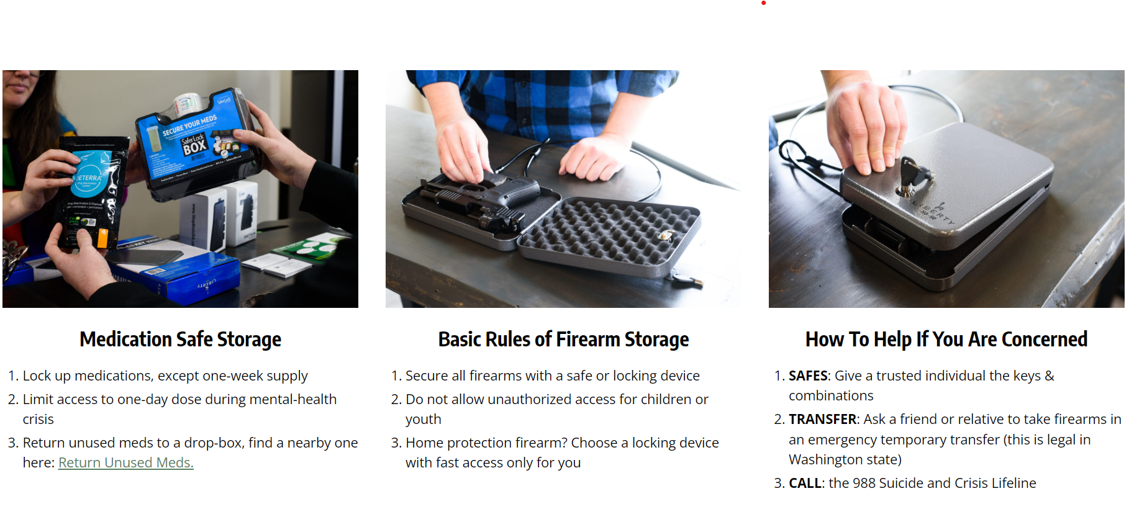
Notes:
Here are examples of what these secure storage options look like.
For medications, we recommend locking up all medications except a one-week supply, and limiting access to one-day doses during a mental health crisis.
Because firearms are the leading cause of suicides in the U.S, we also recommend securing all firearms with a safe or locking device. Youth should not have unsupervised access to firearms, and in Washington State you can give a friend or relative keys and combinations to lockboxes in an emergency transfer.

Slide 53

Next steps
Look for signs
Empathize & listen
Ask about suicide
Reduce the danger
Next steps
LEARN
Notes:
JENNIFER Slides 42-47
The final step in our model is the N step, or “Next steps,” which is about connecting a person in crisis to resources that can help.

Slide 54

Next steps to take
Use a warm handoff immediately
Never leave a student in crisis alone
Relay as much information as possible
Personally connect them to a counselor/crisis team member
  If possible, explain the situation with the student present
Follow crisis plan protocols
Notes:
When responding to a crisis at school:
Never leave a student in crisis alone.
Always use a warm handoff immediately and personally connect a student at risk to appropriate supports.
A warm handoff helps ensure the counselor or crisis team member has as much information as possible about your concern and helps build a relationship in a challenging moment.
ROLE MODEL THIS SAMPLE SCRIPT
This is _______ (student). I wanted to make sure to connect them to more support at school.
_____________ has been struggling lately and when we spoke today, they shared that they are thinking about suicide.
[Provide some details about the issues this student is dealing with, access to lethal means]
_______, is there anything I missed?
Remember to follow all protocols in your school building crisis plan.
Once you’ve completed your next steps, know that you can always continue to check in with the student.
The empathetic connection you built earlier in the steps remains important even when the crisis has passed. If you aren’t sure how to do this, consult with your school’s support team.
[If there is time]
What could you say to encourage help-seeking to someone who might be reluctant?
"Appropriate". Not sure this is the best word choice.

Slide 55

Helpful resources in a crisis
Suicide & Crisis Lifeline:
  Press 1 for veteran services
  Oprima 2 para español
  Press 3 for the Trevor Project
  Press 4 for Native and Strong in Washington
Crisis Text Line:
Text “HEAL” to 741741
Trans Lifeline:
1-877-565-8860
The Trevor Project:
1-866-488-7386
Mande AYUDA para español
LEARN
Notes:
Part of the N step is getting the person you are concerned about to professionals who can assist.
Collaboration, monitoring and linking to crisis resources are all key to helping people stay safe.
Every situation will be different, but keep in mind…seeking care in an emergency room is not always necessary.
Here are a few resources for crisis support.
988 is a national initiative that can answer questions and connect you with a trained counselor to discuss suicide or other crises related to mental health, substance use, and any other emotional challenges. They also provide steps on how to connect someone online who may be in crisis to a safety team.
Crisis Text Line has trained volunteer Crisis Counselors who can respond to anyone on a secure online platform that won’t show up on a phone bill. Washington residents can text using the keyword ‘HEAL.”
The Trevor Project and Trans Lifeline are great resources for our trans/nonbinary and LGBTQ+ youth.
911 is an option if someone is in imminent danger. Please be aware that not every community is comfortable or safe with law enforcement present. In most cases, we would recommend trying the following resources first and using this as a last resort.
It’s OK to test these crisis lines just to practice. Non-emergency calls are always welcome.
All of these resources have access to language interpretation and services specific to special populations (like veterans, LGBTQ+ youth, AI/AN communities).
Remember to stay with the person while they are in crisis.
If you decide to choose any of these listed resources, contact the resource together.
There are more resources provided in your participant packet and on Forefront’s website.

Slide 56






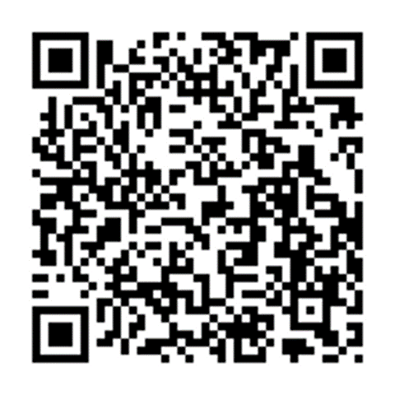
Practicing the LEARN steps
Meet Alex
Alex is withdrawing and isolating from friends (and family);
including increased absences at school.
Alex is struggling with the increased demands of school and a
part-time job and is easily overwhelmed lately.
(Alex also has easy access to large quantities of medication.)
Partner up & choose roles
Practice the LEARN steps
Change roles after 4 minutes
Download the full exercise here:
LEARN
Notes:
FACILITATOR NOTE
Virtual trainings will use breakout rooms! Assign participants into groups of 2. 3 is also OK.
Allow 8 minutes for this activity. We recommend more time if you are able.
Running short on time? At minimum, practice the A step.
Remind participants to switch roles after 4 minutes.
The scenario is also available here: https://redcap.link/comm_learn_scenario.
Now it is time for you to practice putting together the LEARN steps in a practice scenario. You’ll be in small groups of 2-3 for this activity. We know it is tempting to want to discuss the activity rather than practice it, but we highly encourage you to go through these steps at least once today.
We will be using Alex’s story to shape our LEARN conversation. Some of Alex’s warning signs are visible at school, some (in parentheses) are not.
In your groups:
One person will support Alex. (this person will be asking the question about suicide)
The other person will be playing Alex. For this activity, say “YES” during the A-step.
Practice having the LEARN conversation through at least the A-step.
Bonus points for R and N steps that include a warm handoff!
After a few minutes, I will ask you to switch roles.
The more you practice asking “are you thinking about suicide?” the more confident you will be if and when you need to use that phrase with a student or someone in your personal life.

Slide 57
Review: Learning objectives
Explain the public health issue of youth suicide and why young people may consider suicide
1
Identify, understand, and be ready to support someone who may be at risk for suicide
2
Apply the LEARN steps in a practice scenario
3
LEARN
Notes:
We’ve come to the closing section of our training and have now successfully met today’s learning objectives.

Slide 58
Action steps you can take today
Say “died by suicide”
Use what you’ve learned to reach out to someone in distress
Add 24-hour crisis resources into your phone
Make your community safer to help prevent suicide
LEARN
Notes:
We appreciate your participation in today’s training.
Use the skills you learned to reach out to someone you are concerned about as soon as possible.
Say ‘died by suicide.’
Add 24-hour crisis response resources into your phone.
Make your home & school safer by limiting access to lethal means to help prevent suicide.
And finally, don’t forget about your own support systems. You may need to debrief with someone you trust.

Slide 59
LEARN Training Room Needs
BUILDINGS | TOTAL ROOMS | # OF COUNS | MAX PPL PER ROOM | MIN PPL PER ROOM
CWE | 3 | 1 | 19.2 | 14.4
EME | 3 | 2 | 21.0 | 15.8
FVE | 3 | 1 | 18.5 | 13.9
GAE | 2 | 2 | 25.4 | 19.0
HAE | 3 | 2 | 20.6 | 15.5
JAE | 2 | 2 | 21.5 | 16.1
JFE | 2 | 1 | 26.6 | 20.0
LOE | 3 | 1* | 20.4 | 15.3
MAE | 2 | 1* | 25.9 | 19.4
MCE | 3 | 1 | 20.6 | 15.4
MOE | 2 | 1 | 25.5 | 19.1
PCE | 3 | 2* | 21.5 | 16.1
SFE | 2 | 1 | 24.1 | 18.0
SLE | 3 | 2* | 19.1 | 14.3
TCE | 3 | 2 | 21.0 | 15.8
VRE | 2 | 1 | 25.4 | 19.1
WHE | 2 | 1* | 22.8 | 17.1
WOE | 3 | 1 | 18.1 | 13.6
ELEMENTARY
LEARN
Notes:
FOR IN-PERSON TRAINING ONLY - OTHERWISE SKIP
Let’s go through a bit of housekeeping before we begin the training today.
This training will take approximately [60-90] minutes
There will be one activity for you to practice the skills you’ll learn later.
If you have any additional questions, please don’t hesitate to ask.

Slide 60
Thank you!
QUESTIONS?
Notes:
Thank you!
Now we’d like you to please complete our post training survey. You can access the survey by scanning the QR code on the screen or by going to https://redcap.link/fis_learn_post
Forefront uses this data for program improvement - including making sure that we are teaching you effectively. Forefront values anything that you can share.
If you are interested in learning more about Forefront Suicide Prevention, please:
Visit their website intheforefront.org
Connect with them on social media (Facebook, Twitter, and Instagram)
Email them at ffront@uw.edu

